Slide 1
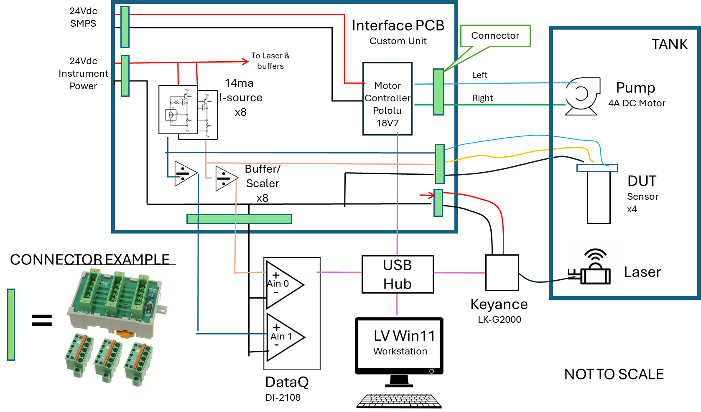
Hardware and Interface PCB block diagram

Slide 2
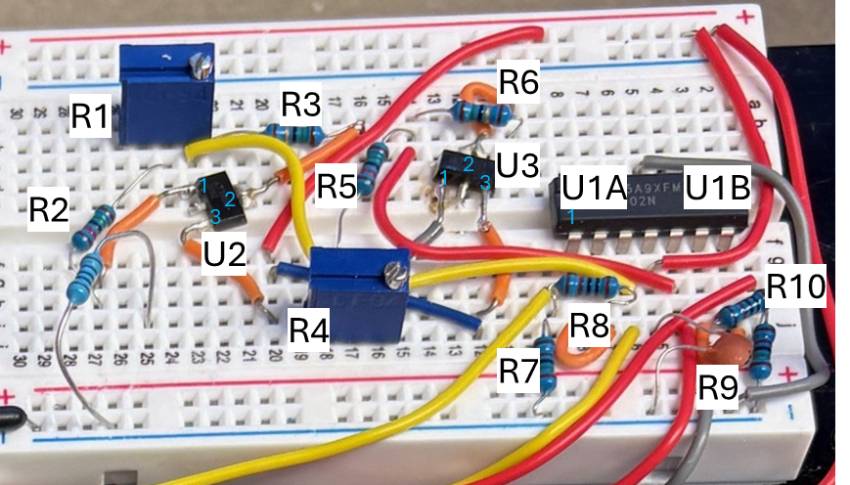
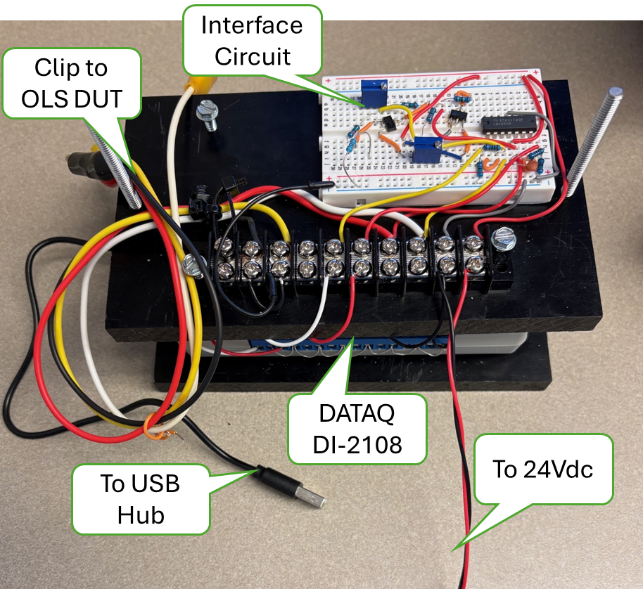
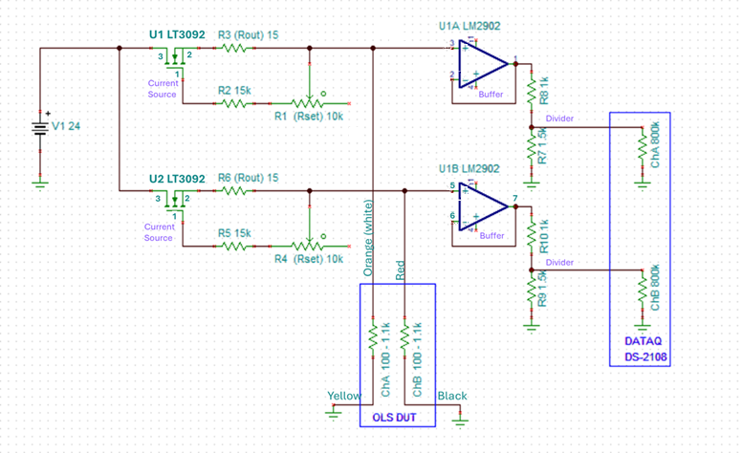
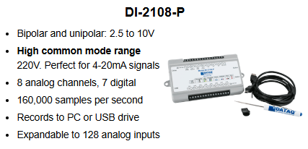
HW and Interface PCB Prototype Schematic and Assy Diagrams
Motor Controller Not Shown
DC Accuracy +/-5mV @10V

Slide 3
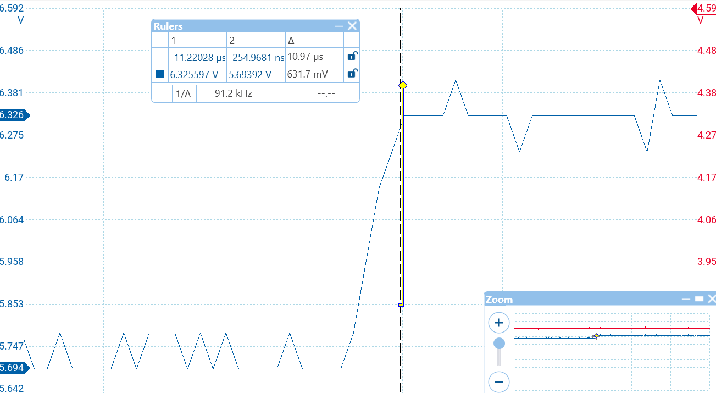
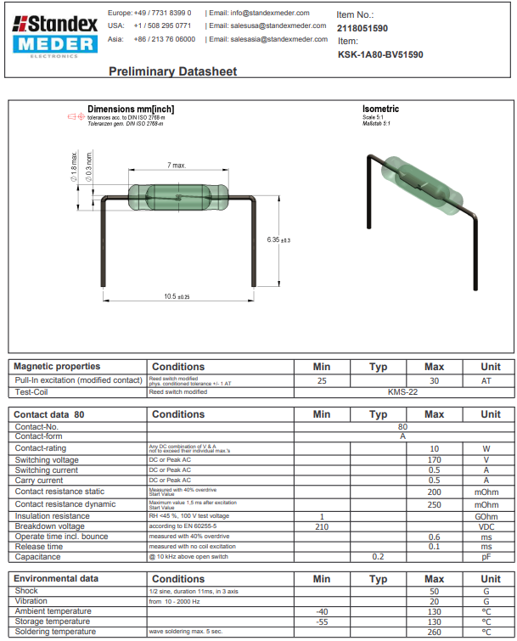
Reed Switch, open->close step response

Slide 4
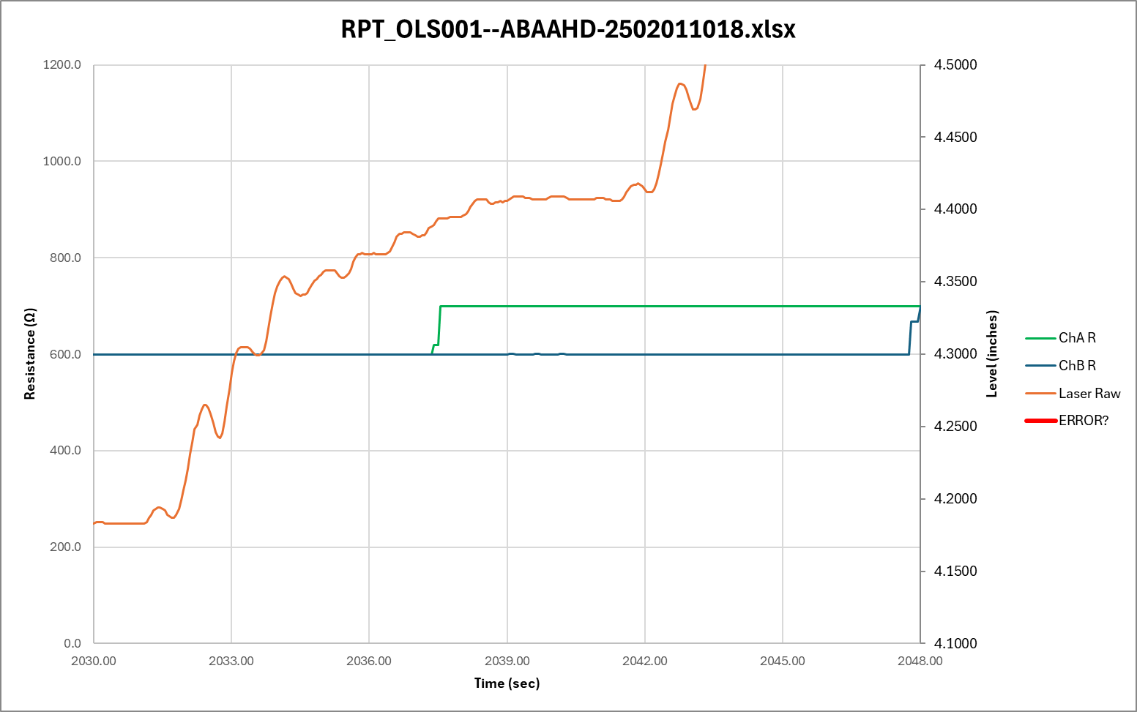
Tank Level step response to 3-speed servo motor control
100%
30%
7%
Waiting

Slide 5
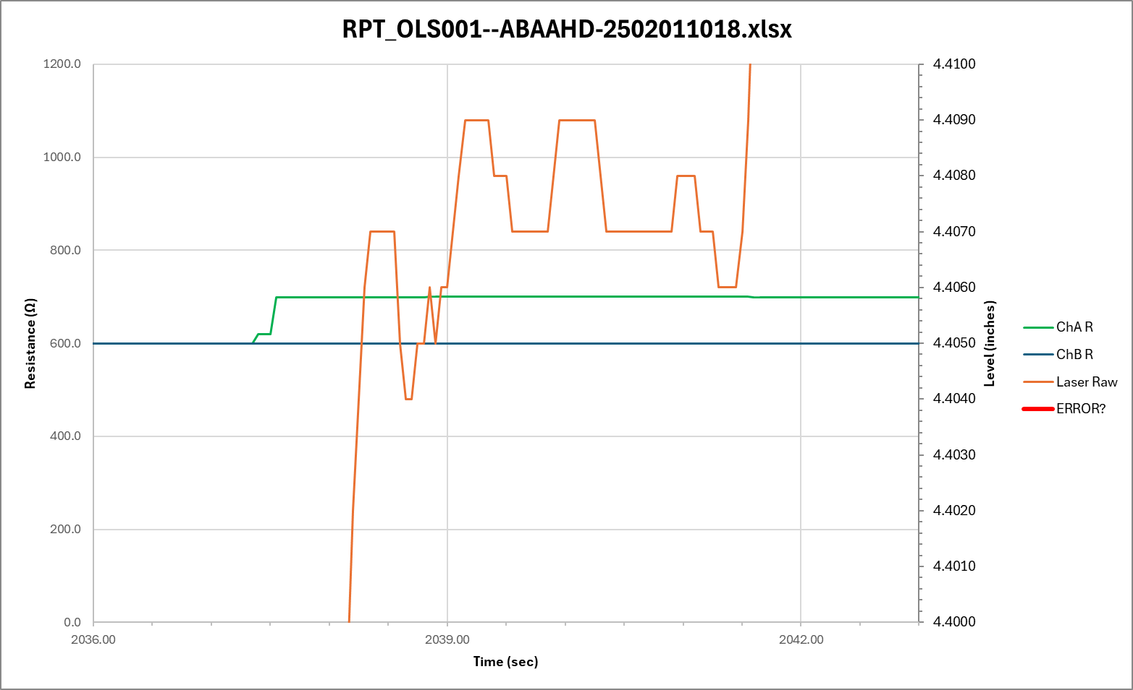
Tank Level step response to 3-speed servo motor control
Zoomed into 3sec wait period
TP Uncertainty

Slide 6
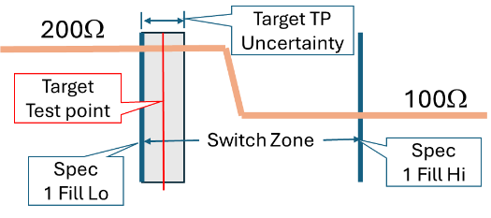
Where to measure resistance to determine “has switched” PASS/FAIL
Full
Empty
LEVEL
The Target Test Point Level (TP) will be set to ½ the level measurement uncertainty after 3 second settling time, prior to the specified upper bound of the Switch Zone.
REQUIREMENT: The Target Test Point uncertainty shall not exceed ???”.
To be defined

Slide 7
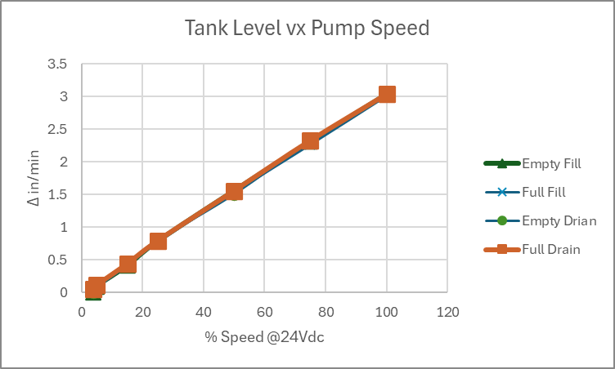
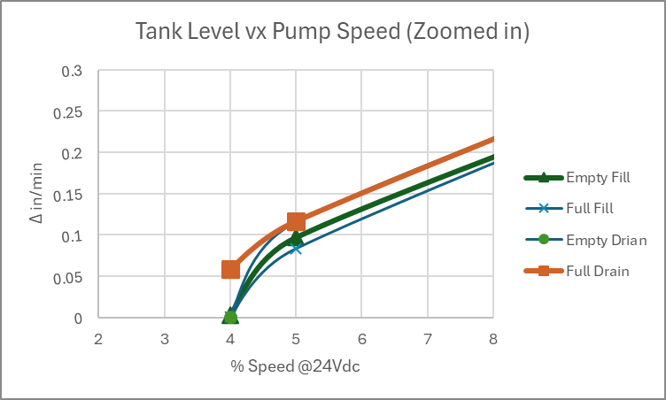
Tank Level Response at various motor speeds
Using the Pololu MC18V7 PWM motor controller with Vs set to 24Vdc, The Δ Level was measure for 30 seconds at various percent of max speed (100% duty cycle) for both FILL and DRAIN at near EMPTY and near FULL.
The response has a minor shift at each case but is basically linear down to about 5% resulting in fill rate of about 0.1”/min where the control becomes unstable by 4% as shown in the ‘Zoomed In Plot.
Without doing an extensive fluid analysis, this response is assumed to be adequate for the MLOI application.
Data from mloi:\PM_Folder\_3 Develop\Design Calculations.xlsx sheet Tank. 3/4/2025 R. Ales

Slide 8
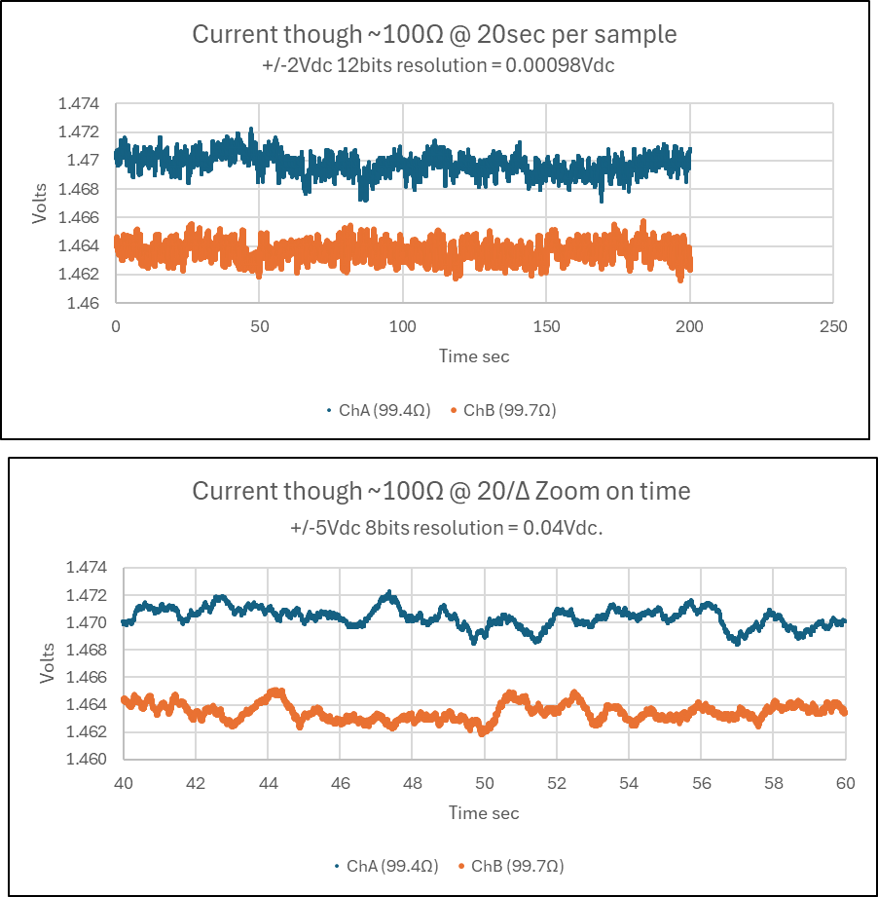
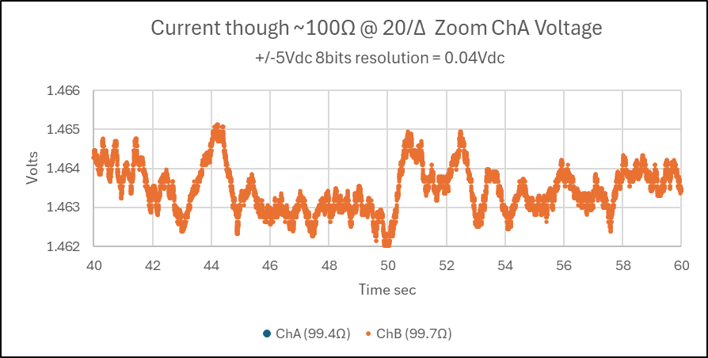
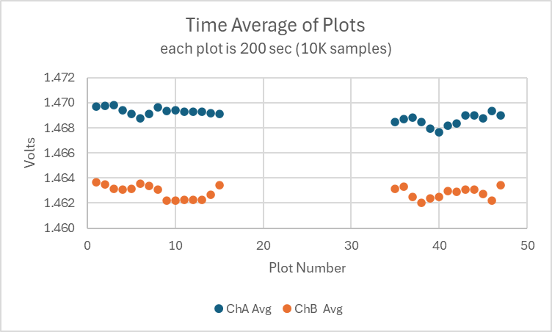
Breadboard LT3092 Current Source Drift over 15 hours
One Plot (marker)

Slide 9
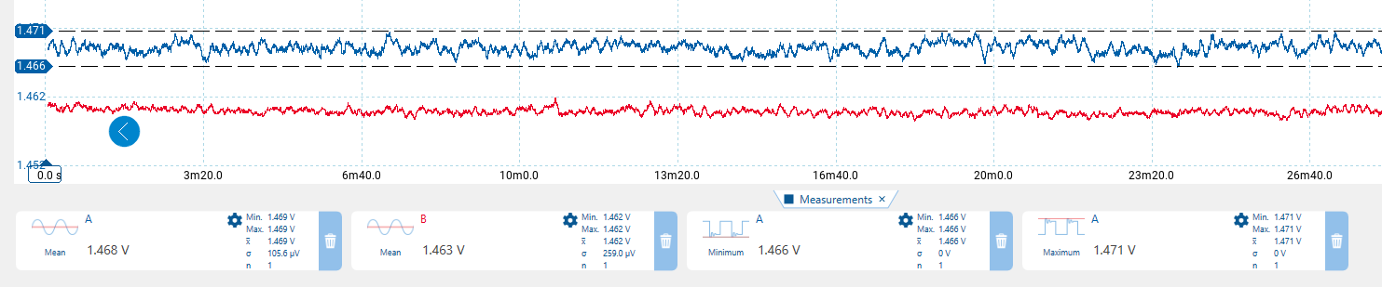
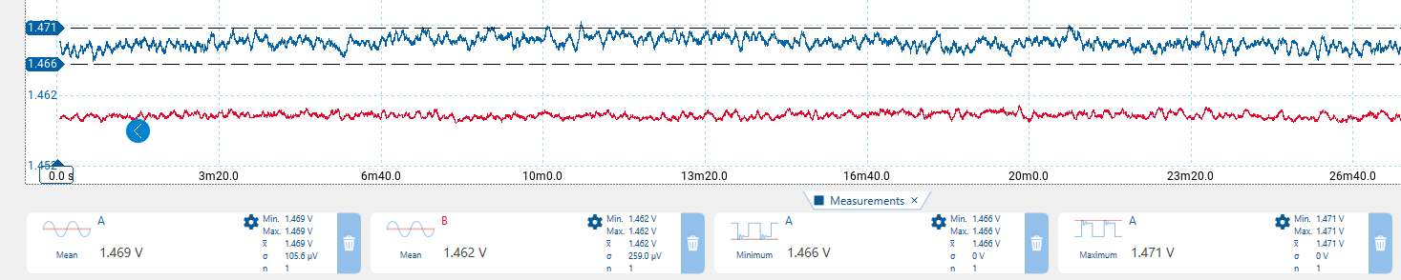
Current source stability over 15 hrs, Start and End trace, 2000 seconds each trace
Time 0 -26min ChA Blue, ChB Red
Mean 1.468V (1.477ma) 1.463V (14.67ma)
Time 14h26min – 15hrs ChA Blue, ChB Red
Mean 1.469V (14.78ma) 1.462V (14.66ma)

Slide 10

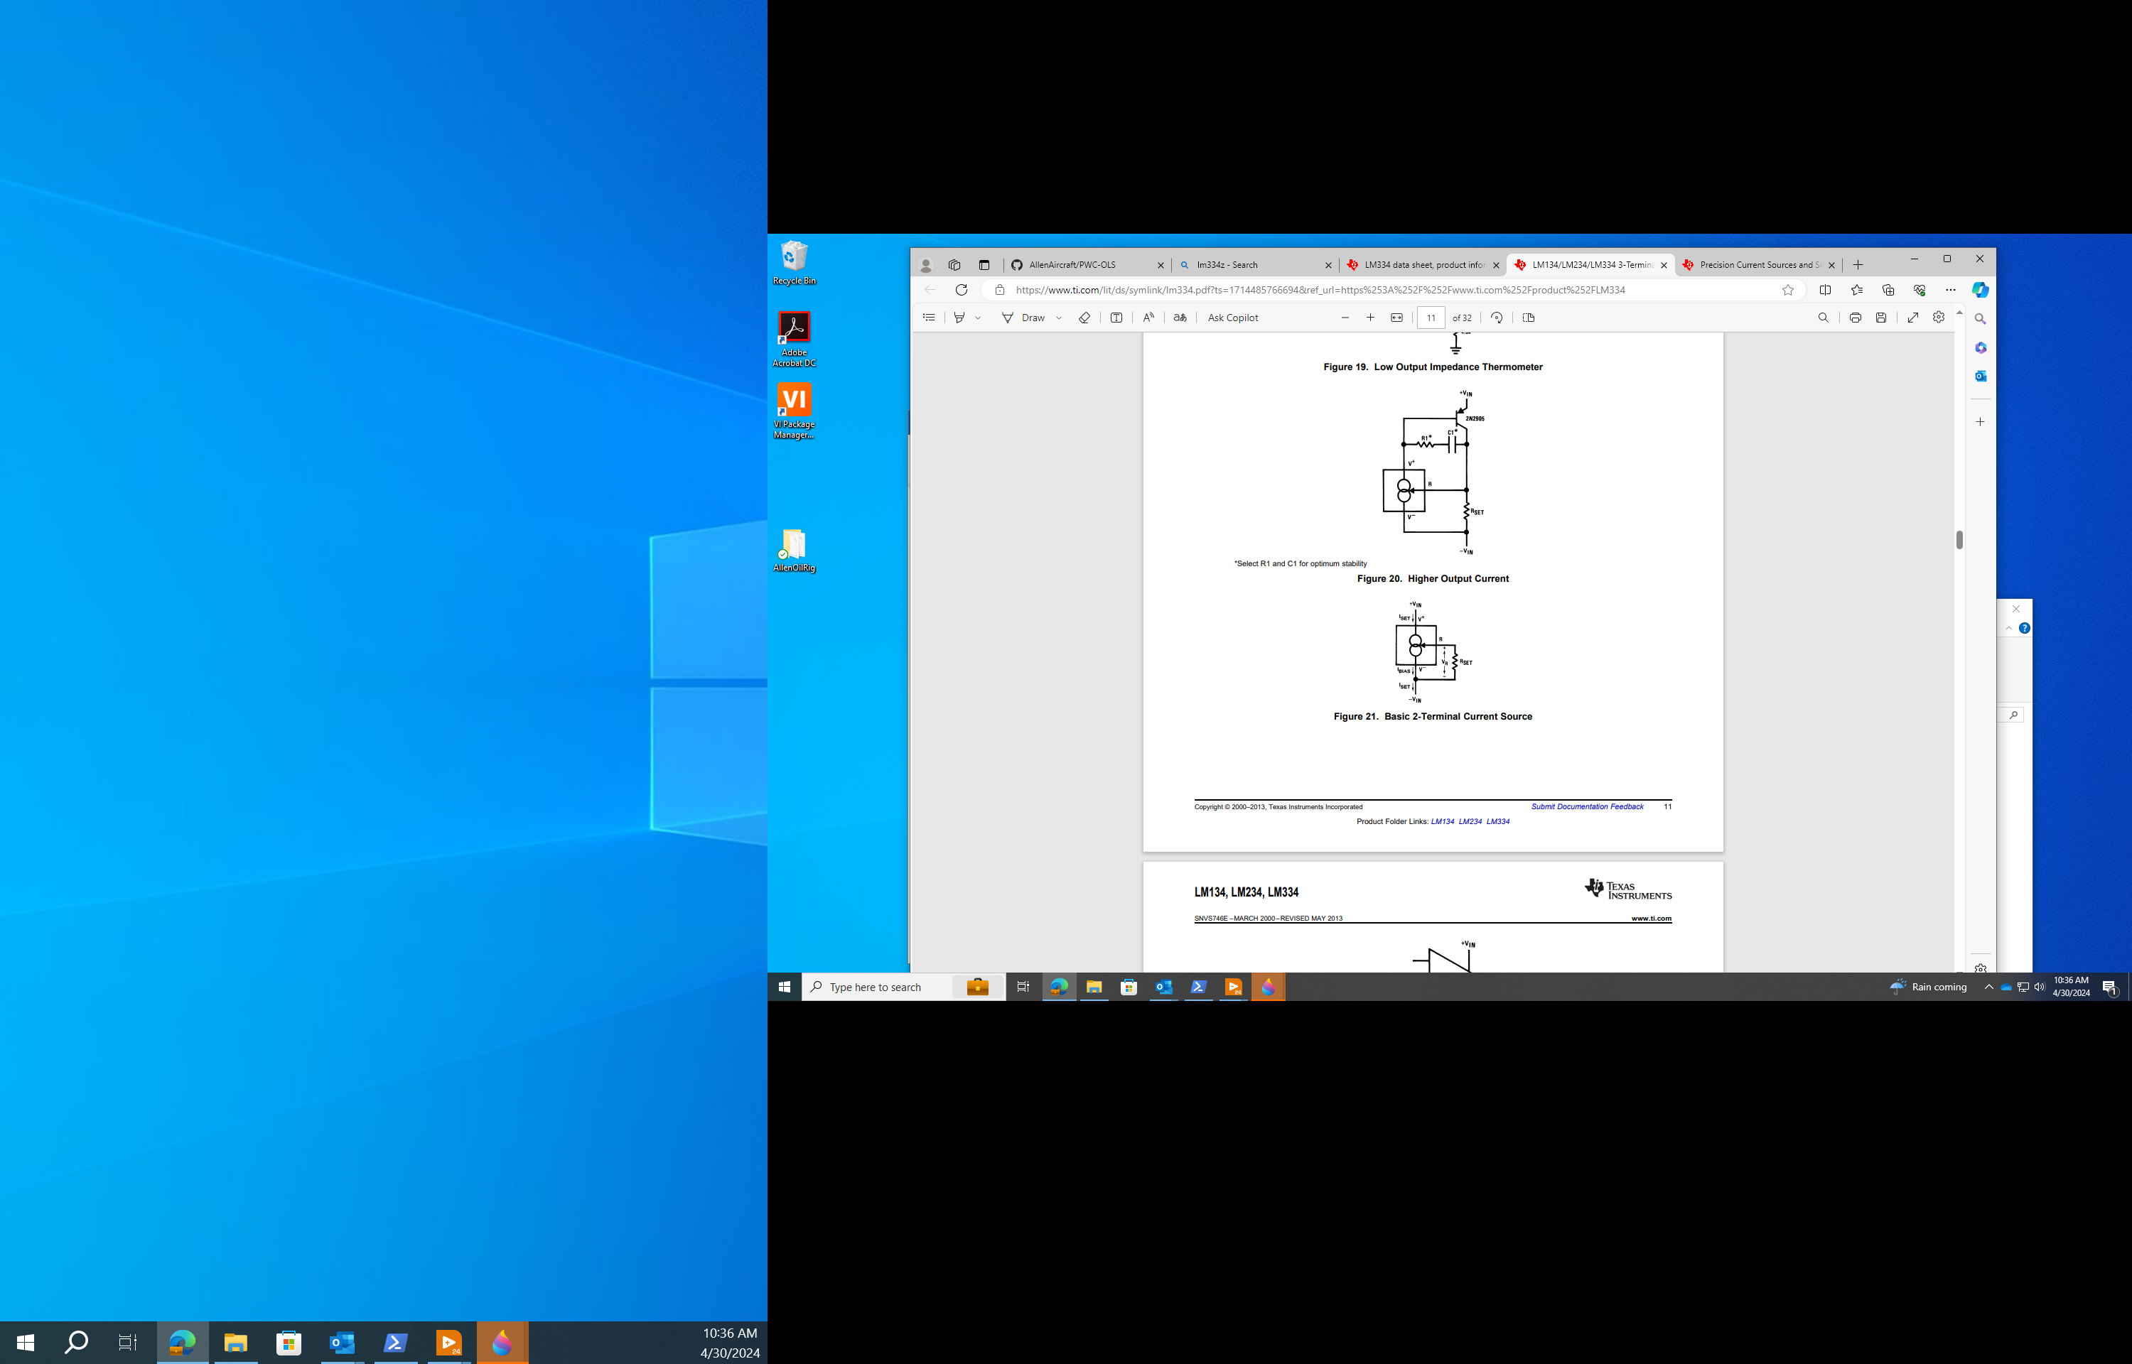


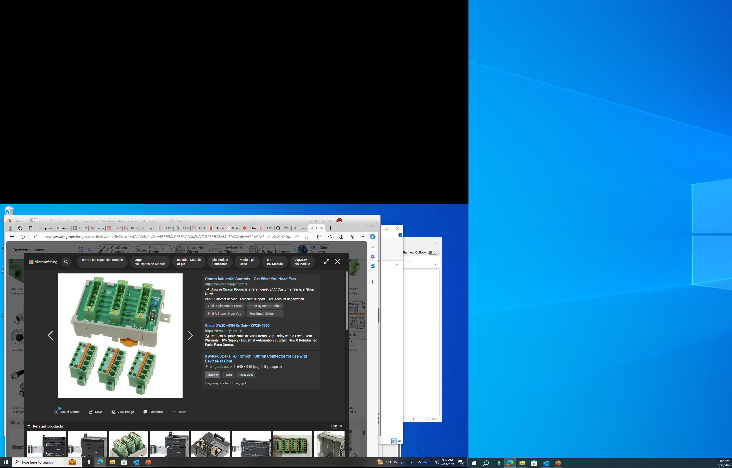
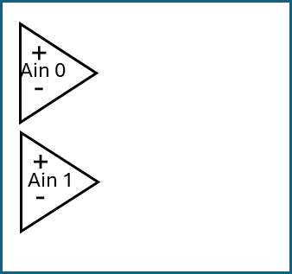

24Vdc
SMPS
24Vdc
Instrument
Power
Interface PCB
Custom Unit
Connector
TANK
To Laser & buffers
14ma
I-source
x8
Left
Right
Pump
4A DC Motor
Motor
Controller
Pololu
18V7
Buffer/
Scaler
x8
DUT
Sensor
x4
CONNECTOR EXAMPLE
USB Hub
Laser
=
Keyance
LK-G2000
LV Win11
Workstation
DataQ
DI-2108
NOT TO SCALE

Slide 11
24Vdc
SMPS
24Vdc
Instrument
Power
Interface PCB
Custom Unit
Connector
Left
Right
Motor
Controller
Pololu
18V7
14ma
I-source
x8
Buffer/
Scaler
x8
Pump
4A DC Motor
+5Vdc
USB Hub
Laser
Keyance
LG-K
DUT
Sensor
x4
LV Win11
Workstation
DataQ
DI-2108

Slide 12
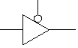
Tri-state
Buffer
Motor
Controller
x4
On/Off
Fwd/Rev
Left
Right
+5Vdc
Do-6
-
+
Ain 0
Do-5
-
+
Do-4
Ain 1
DUT
Sensor
x4
DataQ
DI-2108

Slide 13
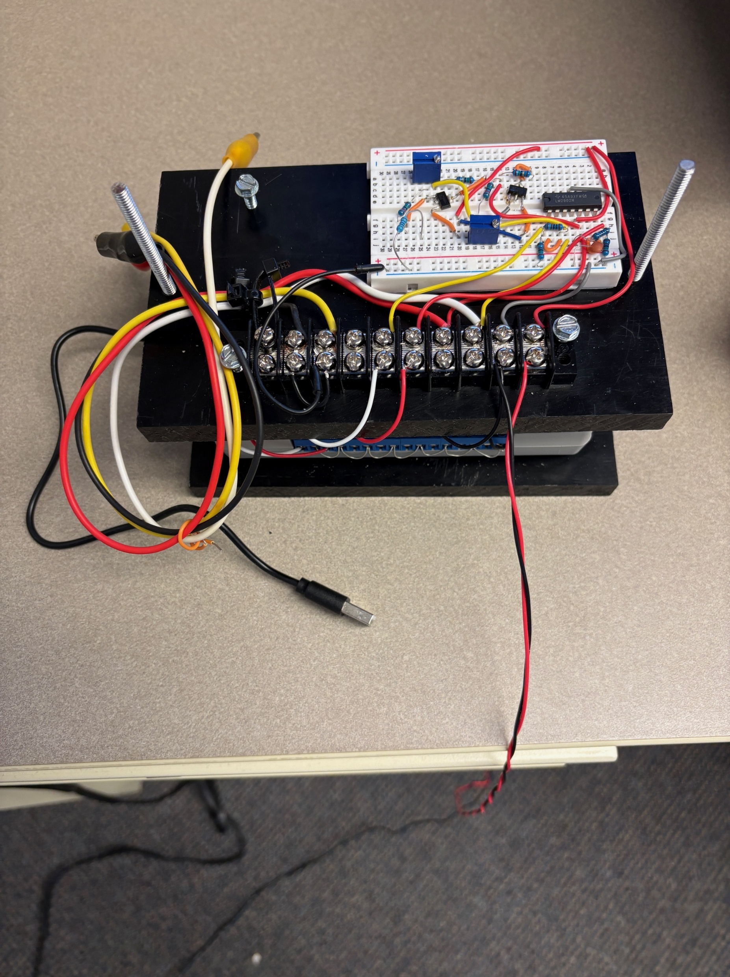
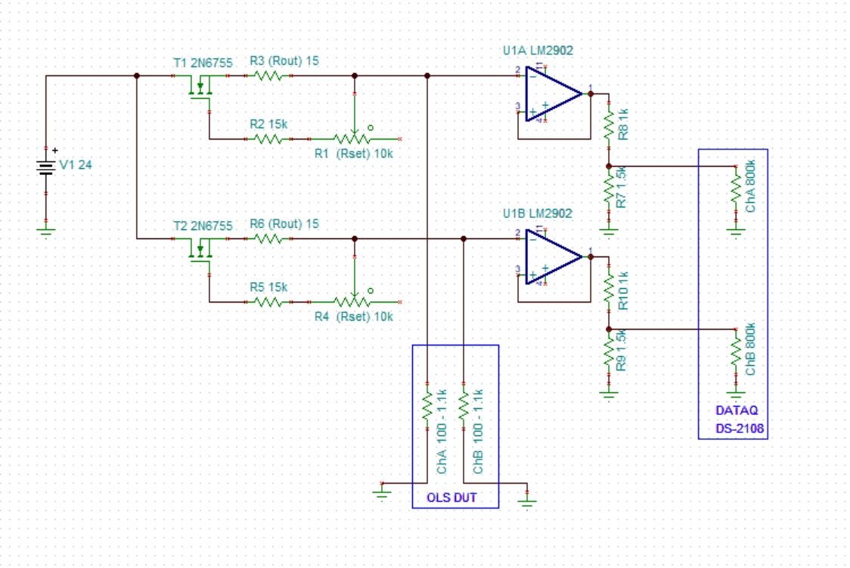

Interface
Circuit
Clip to
OLS DUT
DATAQ
DI-2108
To 24Vdc
To USB Hub
R6
R1
R3
R5
1
2
U3
R2
1
2
3
U1A
U1B
3
1
U2
R10
R4
R8
R7
R9

Slide 14
Interface
Circuit
Clip to
OLS DUT
DATAQ
DI-2108
To 24Vdc
100Ω Ref Resistor
R6
R1
R3
1KΩ Ref Resistor
R5
1
2
U3
R2
1
2
3
U1A
U1B
3
1
U2
R10
R4
R8
R7
R9

Slide 15
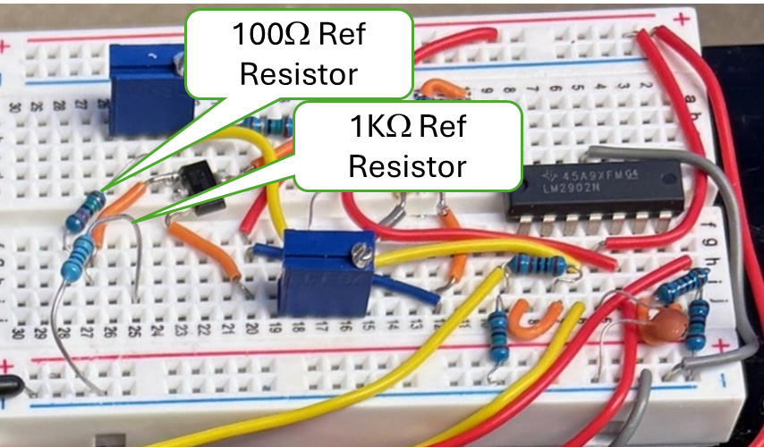
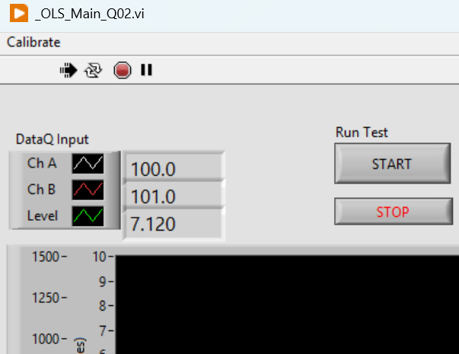
Read App
Resistances Here

Slide 16
200Ω
Target TP Uncertainty
Target TP
(Test point)
Switch Point
100Ω
Switch Zone
Spec 1 Fill Hi
Spec 1 Fill Lo
Test Set Point
RNG_Stop
Target TP Uncertainty
200Ω
Target TP
(Test point)
Switch
Point
100Ω
Switch Zone
Spec 1 Drain Hi
Spec 1 Drain Lo
Test Set Point
RNG_Stop
Full
Empty
LEVEL

Slide 17
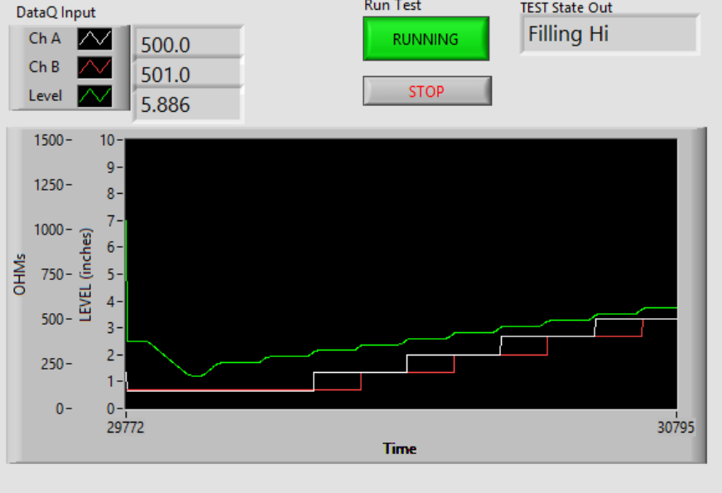
Numeric
Outputs
Test Protocol
Current State
FULL
Level Filling Shown
(opposite of ATP Spec}
Ch A & Ch B
Resistance
EMPTY

Slide 18
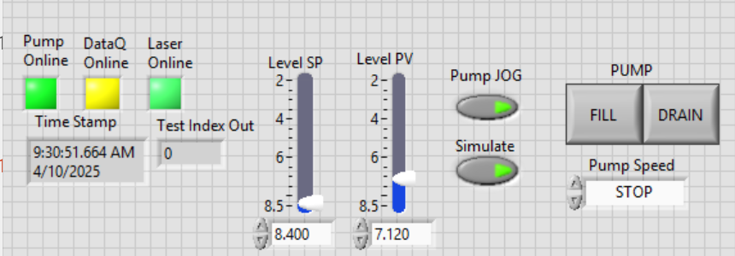
STATUS

Slide 19

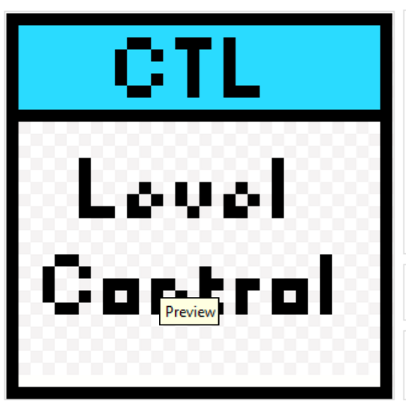


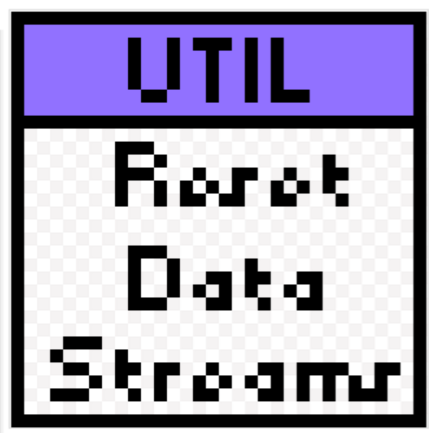



Slide 20
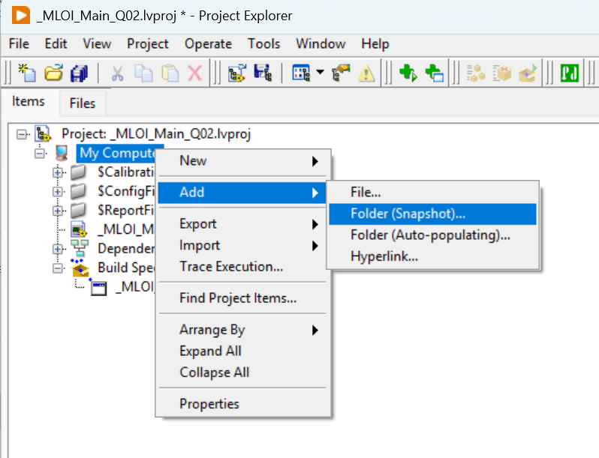
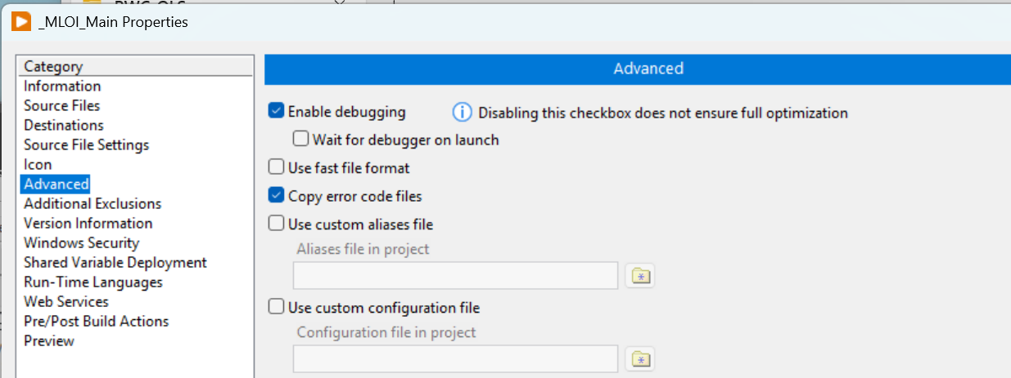
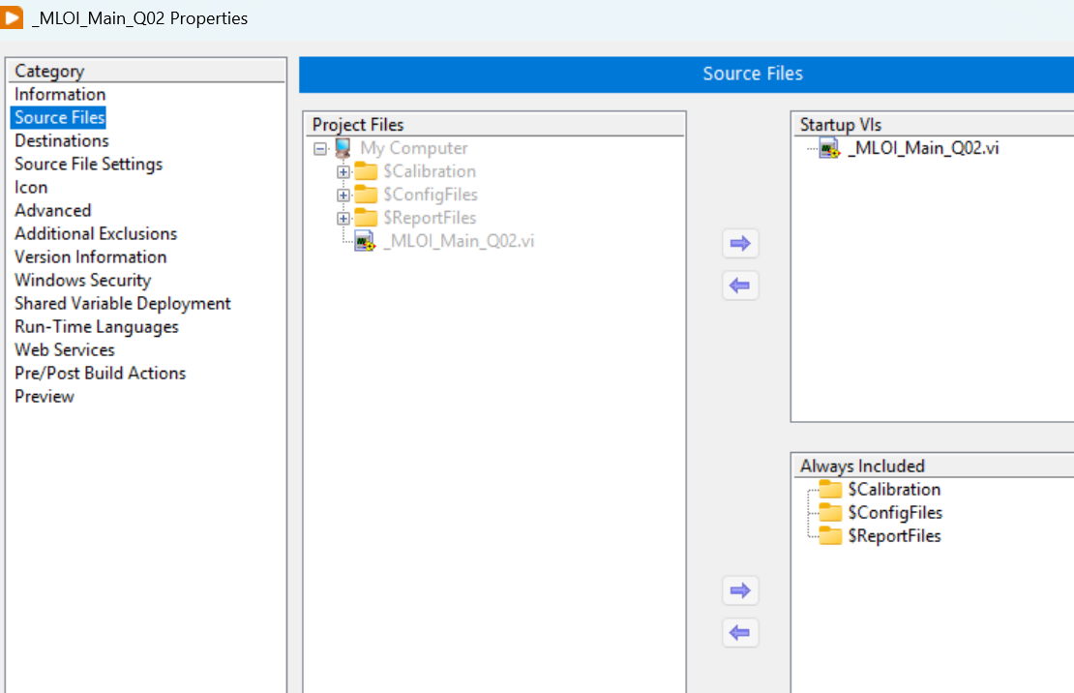
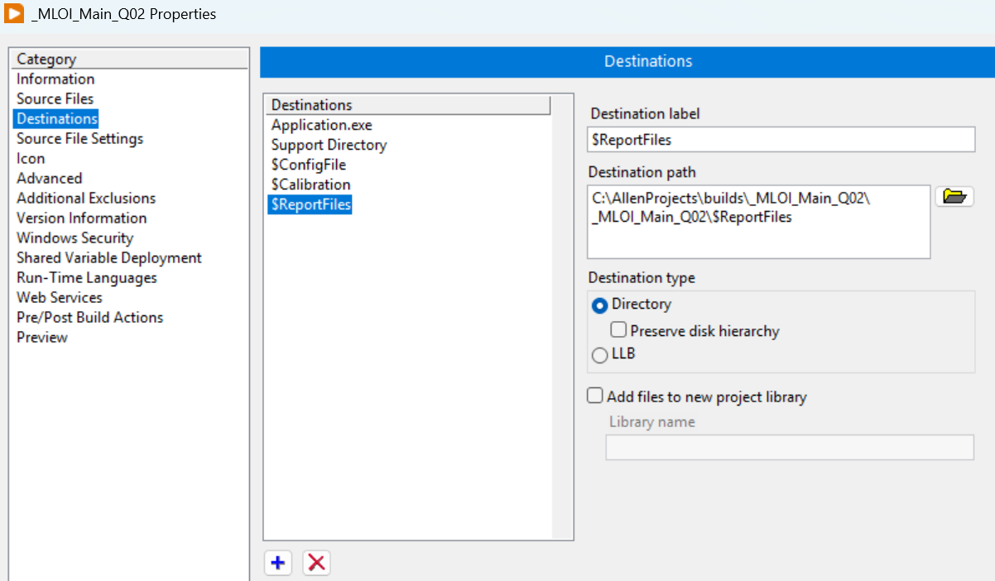
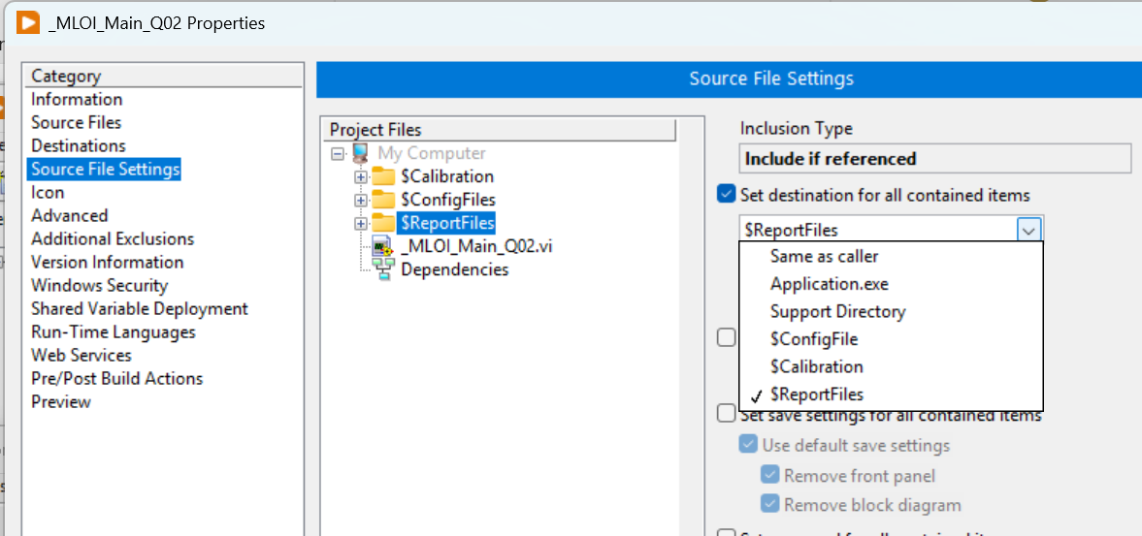
1 Add a “Snapshot folder to the project
2 Slide the folder to be included to “Always Include” List
5 In Advance, enable the Debugger as a bug workaround suggested by NI.
4 The destinations will show in the ‘Set destination” drop down so link each folder in the ‘project folder’ tree to its path in the destination dropdown.
3 Press the ‘+’ to add the folder to the Destination.

Slide 21
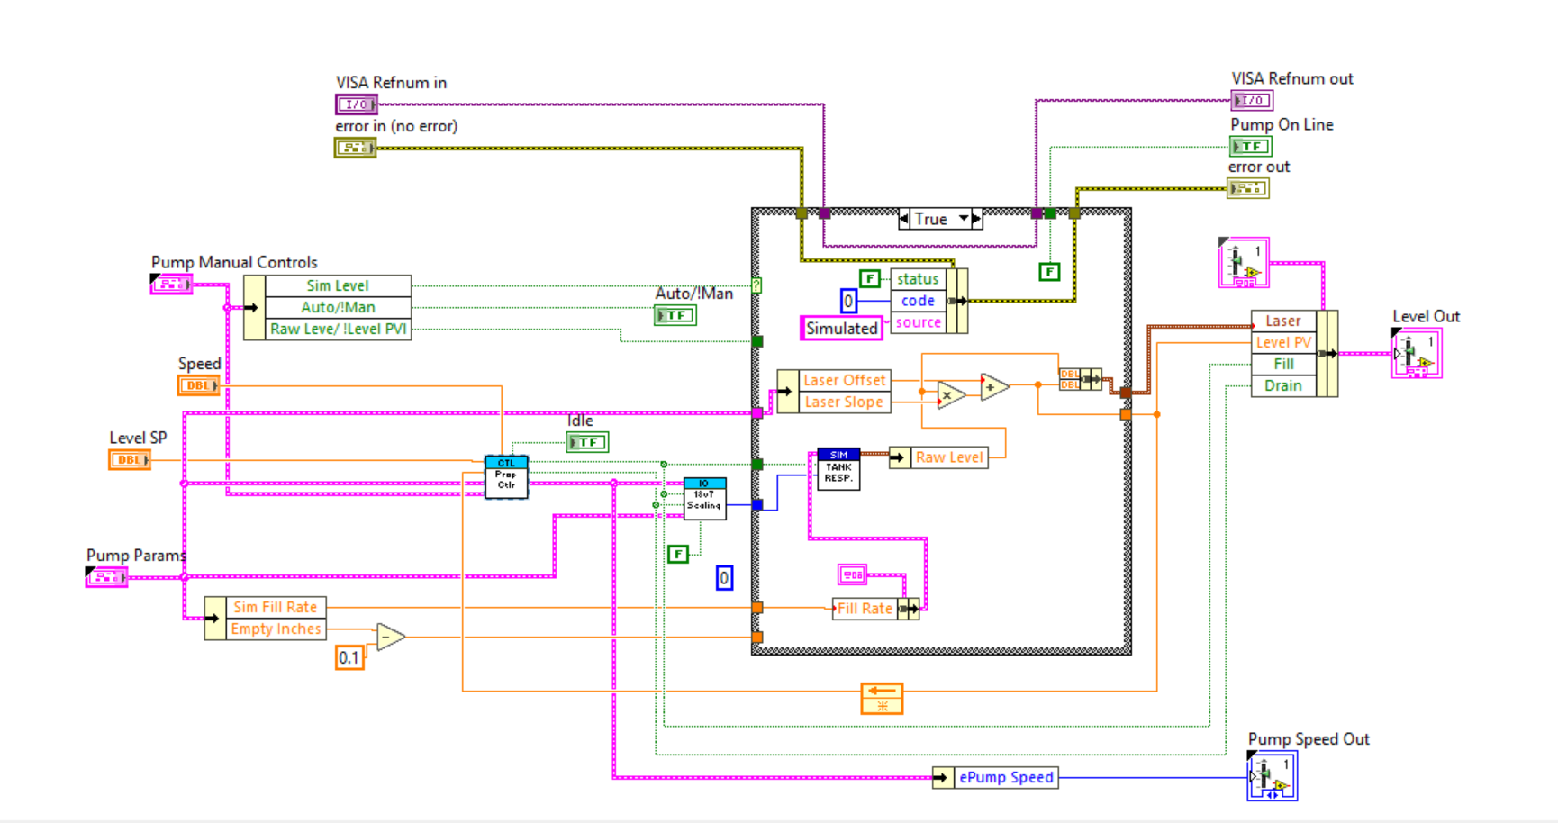
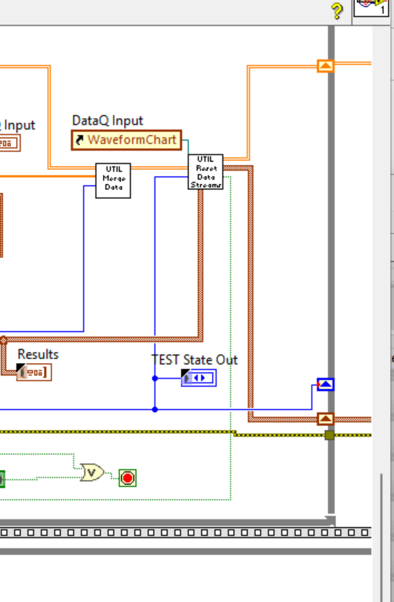

Slide 22
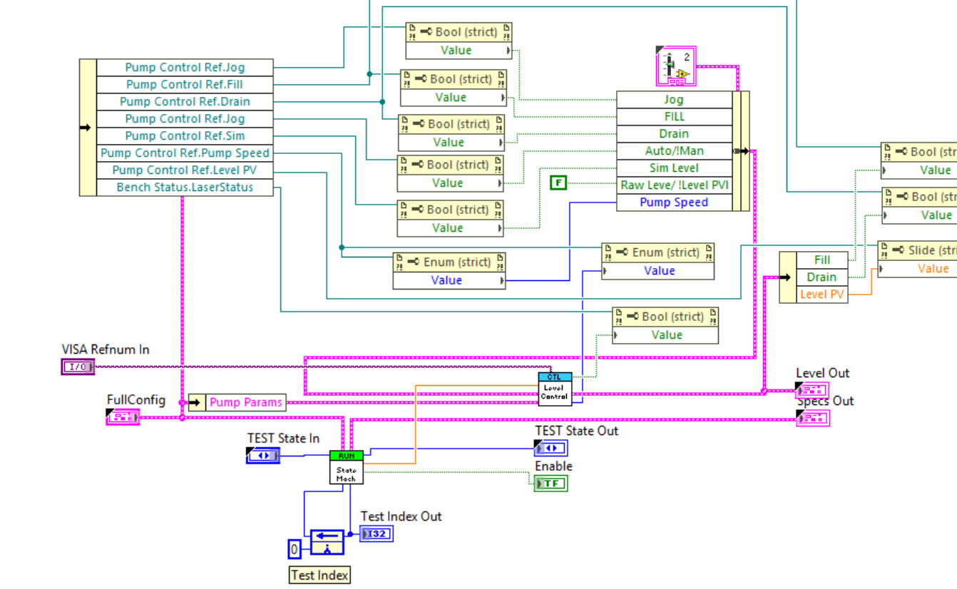

Slide 23
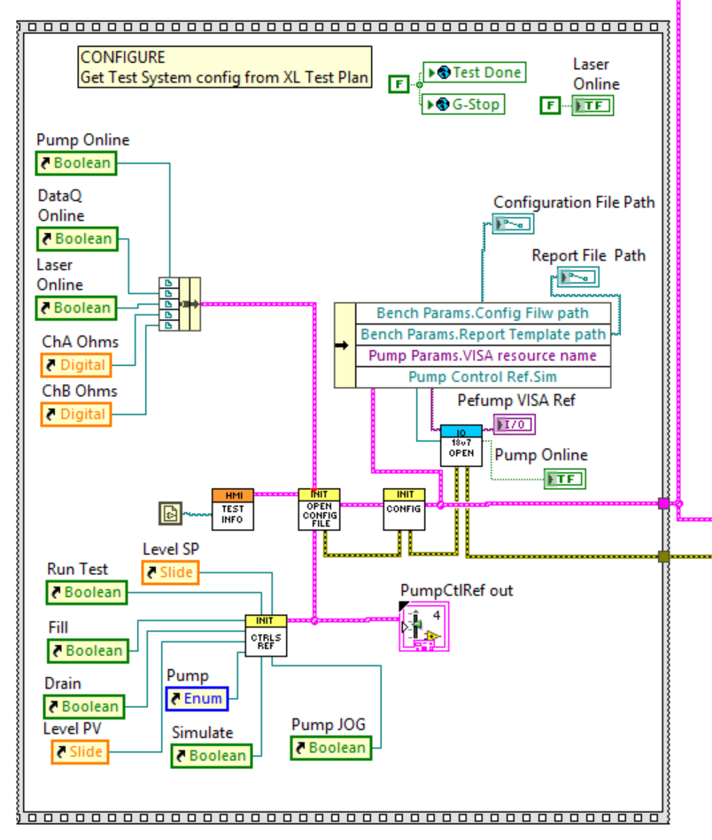

Slide 24
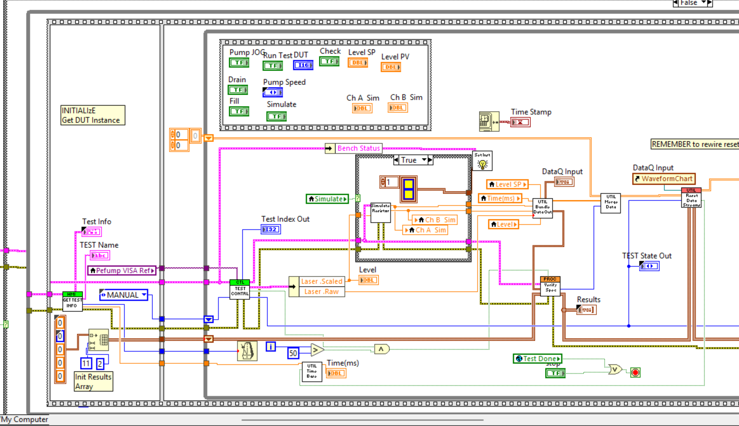

Slide 25
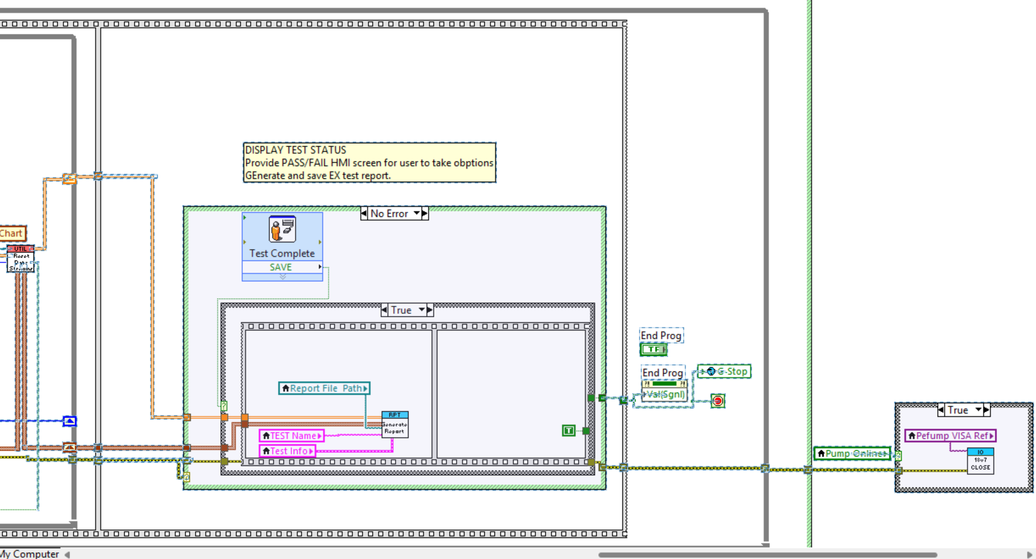

Slide 26
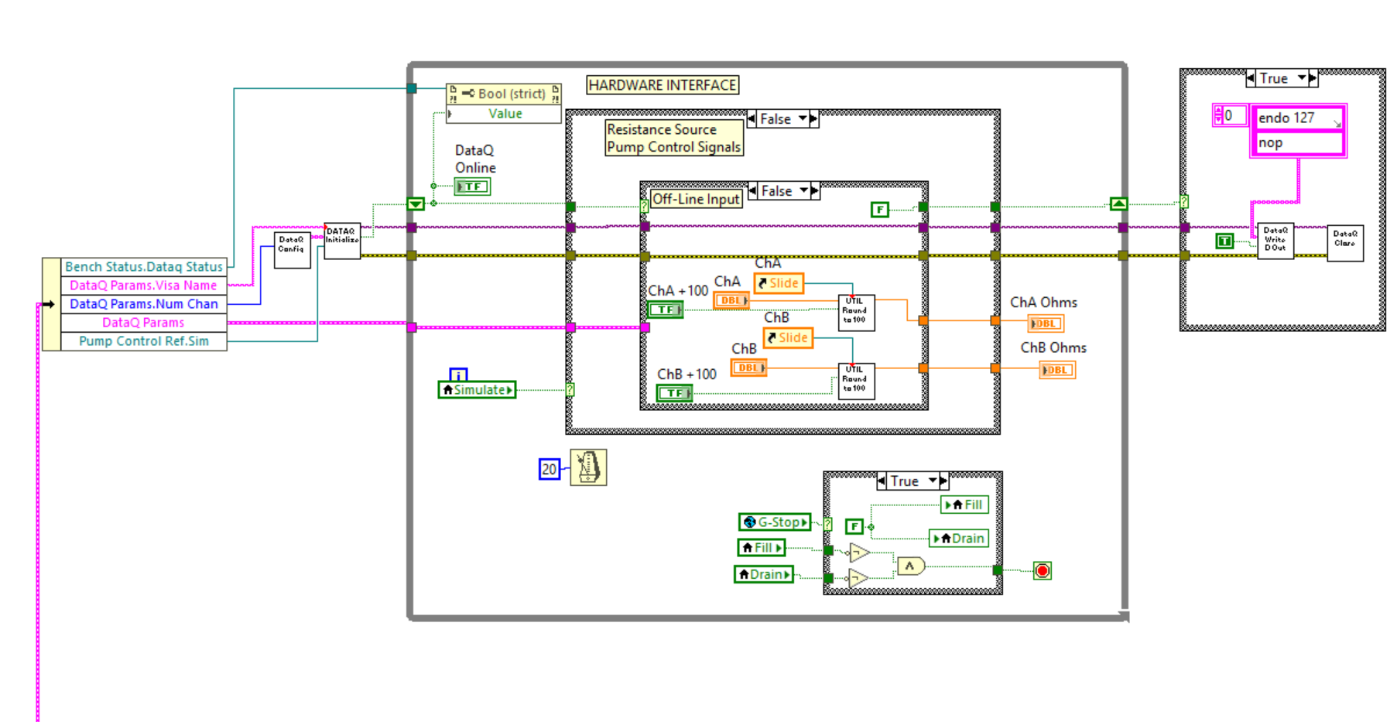

Slide 27
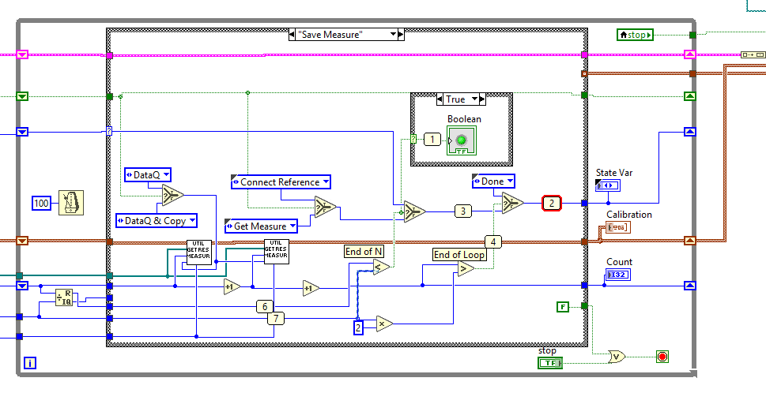

Slide 28
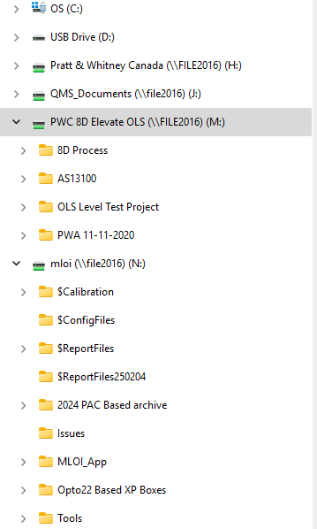
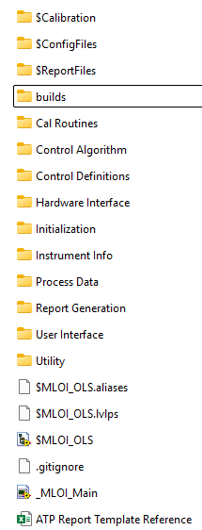
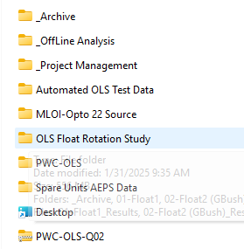
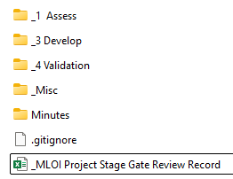

Slide 29
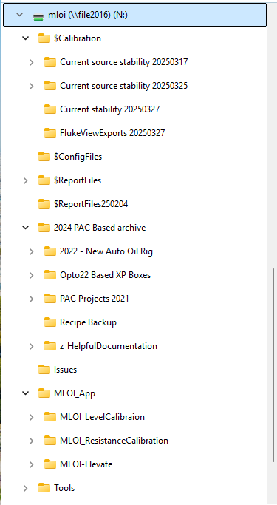
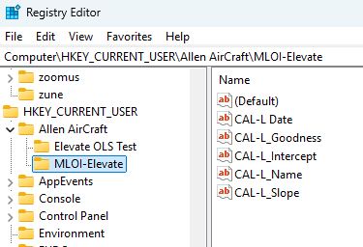

Slide 30
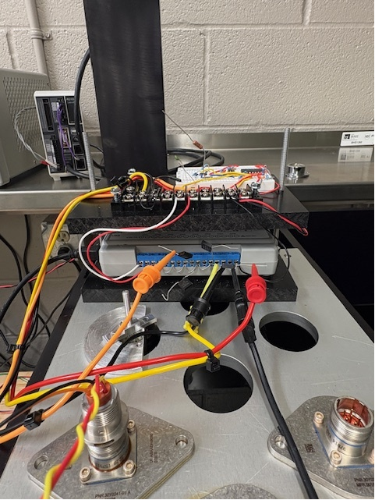
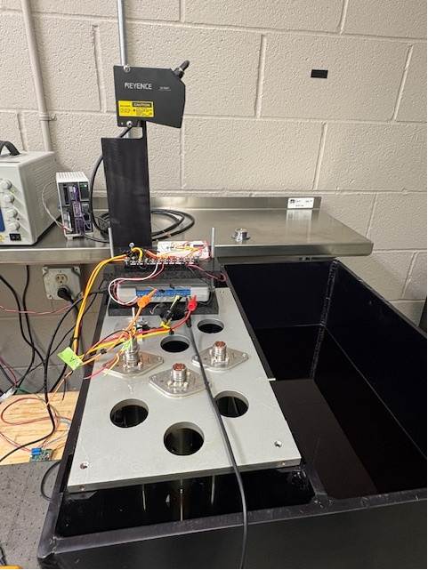



Instrument
24Vdc Power
LK-G3000
Control Unit
LK-G3000
Laser Head
Pump
24Vdc Power
DataQ & PCB
Data Acquisition
MLOI Tester
Workstation
Test Tank Plate
Level Datum
Test Tank
Instrument
USB Hub
18V7 Motor
Controller

Slide 31


Mitutoyo
Depth Gage
Yellow Zero Button
12” Probe
Probe touching Datum
Tank Plate
Zero Datum
Tank Plate
Zero Datum

Slide 32


LCD Readout
Adjustment Handle
1st OLS Position

Slide 33

Menu bar
Program Running
Indicator (Black)

